Slide 1
The Art of Compassionate Leadership
Mary Tellis-Nayak, RN, MSN, MPH
Wellness Nurse for the Chicago School Sisters of Notre Dame

Slide 2
Overview
Compassion is at the core of healthcare
Establishing a culture of compassion in your community
Sympathy, empathy, compassion – how they differ
The physiology of compassion
The survival of the “kindest”
What do residents desire? What do staff desire?
How to awaken compassion in your workplace.

Slide 3
Healthcare is more than a service enterprise it is a peoples’ enterprise.

Slide 4
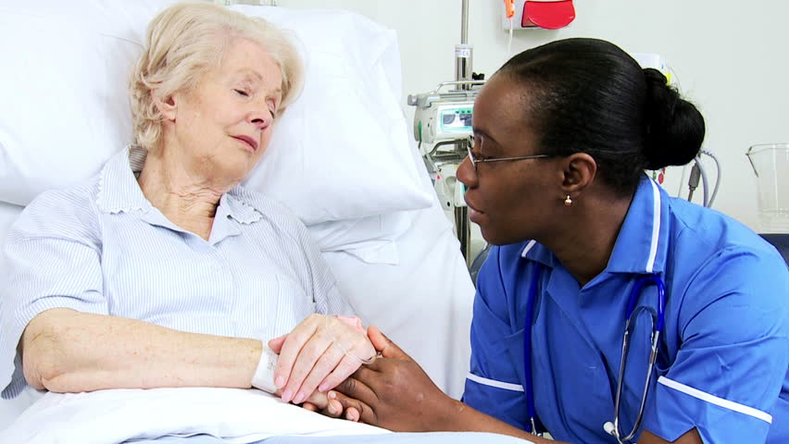
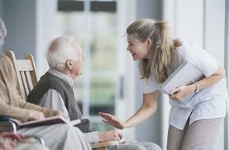

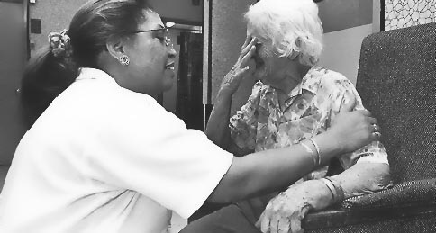
Healthcare is a relational art. Compassion is at its core.

Slide 5
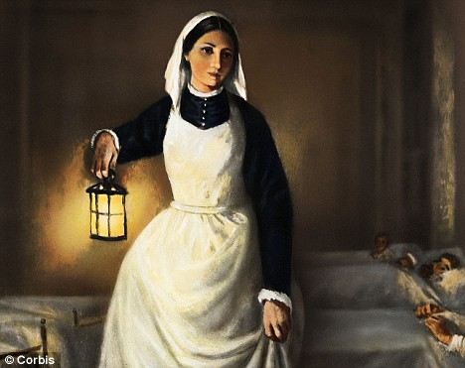
What Would Florence Say?
“Taking care of the sick should be a mission, not just a business and being a nurse……should be a calling, and not just a job.”

Slide 6
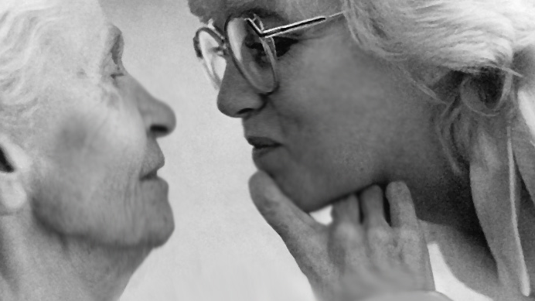
There is no human relationship more intimate than that of care-giver and the care-receiver

Slide 7


Which one is indicative of your nursing staff in 2021?

Slide 8
The Challenges You Face Today
COVID 19
Testing and equipment
Staffing
Occupancy
Perceptions
Funding
Exhaustion
Burnout
Time

Slide 9

https://greatergood.berkeley.edu/quizzes

Slide 10
Polling Questions

Slide 11
I have a strong and reliable network of supportive colleagues at work.
1) Strongly Disagree
2) Disagree
3) Neither Agree nor Disagree
4) Agree
5) Strongly Agree

Slide 12
At my workplace, we routinely thank each other for everyday efforts and contributions to success.
1) Strongly Disagree
2) Disagree
3) Neither Agree nor Disagree
4) Agree
5) Strongly Agree

Slide 13
At my work, my colleagues and I think of each other as friends.
1) Strongly Disagree
2) Disagree
3) Neither Agree nor Disagree
4) Agree
5) Strongly Agree

Slide 14
There is a high level of trust throughout my workplace.
1) Strongly Disagree
2) Disagree
3) Neither Agree nor Disagree
4) Agree
5) Strongly Agree

Slide 15
The work we do in my organization serves a greater purpose.
1) Strongly Disagree
2) Disagree
3) Neither Agree nor Disagree
4) Agree
5) Strongly Agree

Slide 16

If you have answered “agree” or “strongly agree” to most of these five questions, you are likely working in a community where there is a culture of compassion .

Slide 17
Leaders Create Compassionate Cultures
Do You?

Slide 18

Think of someone in your life
who
has been an effective leader
What qualities did he/she have?
Notes:
LEADERS YOU ADMIRE – Divide the group into small groups. Ask participants to share a story about the best or most influential leader that they have encountered. After each story, identify leadership characteristics : What was it that made this person such an effective leader? Then as a group idenitfy the traits that all the leaders seemed to share.
NEED A PAPER IN THE HANDOUT ENTITLED: TRAITS OF AN EFFECTIVE LEADER

Slide 19
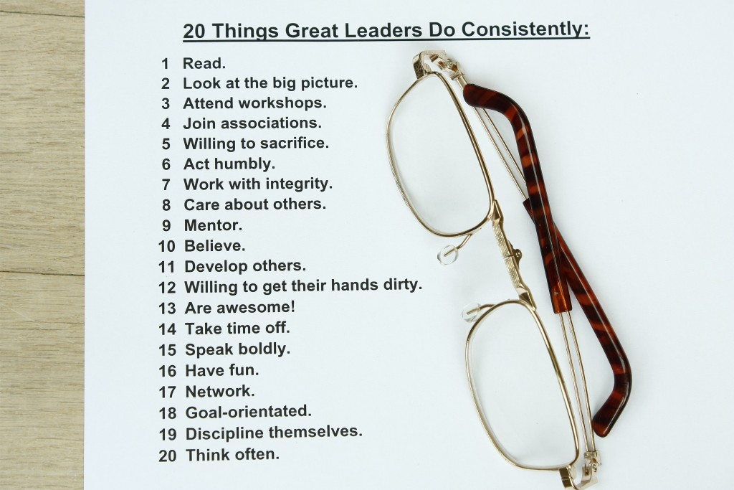
Check off those you feel your staff would say about your leadership
Add others that you feel may not be here but are your strengths.

Slide 20
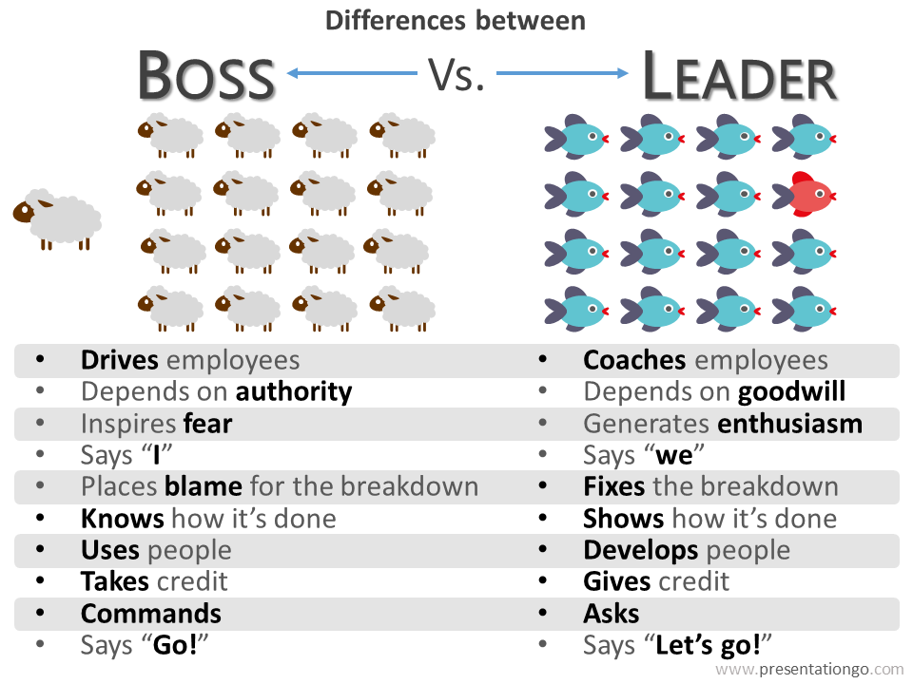

Slide 21

It’s all about
Leadership

Slide 22
While some industries favor a more rigid corporate structure, it's been argued that showing compassion in the workplace increases employee retention, decreases stress, and even improves health
The 1 Rule of Leadership That Will Make Others Want to Follow You
BY MARCEL SCHWANTES, FOUNDER AND CHIEF HUMAN OFFICER, LEADERSHIP FROM THE CORE@MARCELSCHWANTES

Slide 23
Creating a Compassionate Culture at Work
Show appreciation – Celebrate
Make a positive impact – be known in your neighborhood for compassion
Lead by example – show YOU are invested in your work
Respond with authenticity – listen to their concerns and help them grow
Equip your team to take care of business – empower staff to carry out the vision
One study found that organizations characterized by higher levels of compassion (and other virtuous behaviors, like forgiveness) increased performance, innovation, customer retention, profitability, and quality. And, yes, these same firms also had considerably less employee turnover.

Slide 24
So, What is Compassion?
How does it differ from
empathy and sympathy?

Slide 25
Compassion is an emotion that is a sense of shared suffering, most often combined with a desire to alleviate or reduce the suffering of another; to show special kindness to those who suffer. Compassion essentially arises through empathy, and is often characterized through actions, wherein a person acting with compassion will seek to aid those they feel compassionate for.

Slide 26

Notes:
Imbedded video

Slide 27
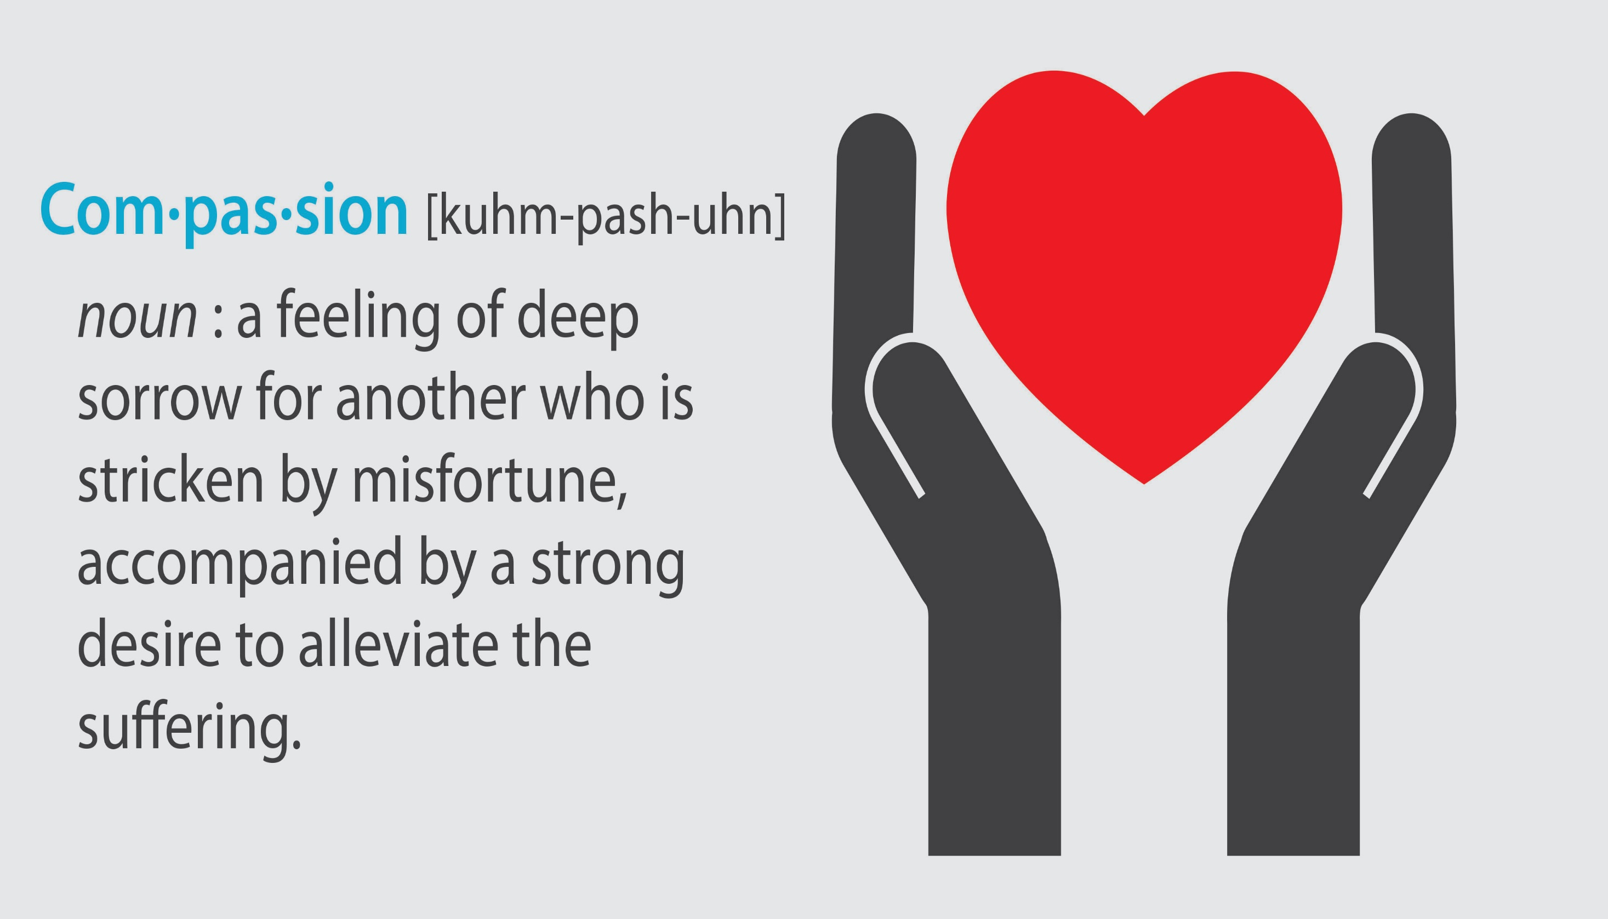

Slide 28
The Anatomy of Empathy
Using scanning technology, scientists can identify part of the brain that are active when we empathize with others. By combining those results with other findings, from psychological evaluations to genetic testing – researchers are beginning to determine which biological and environmental factors reinforce or corrode our capacity for empath.

Slide 29
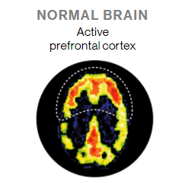
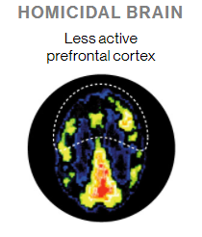
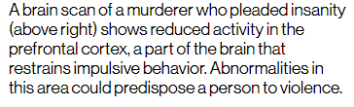

Slide 30
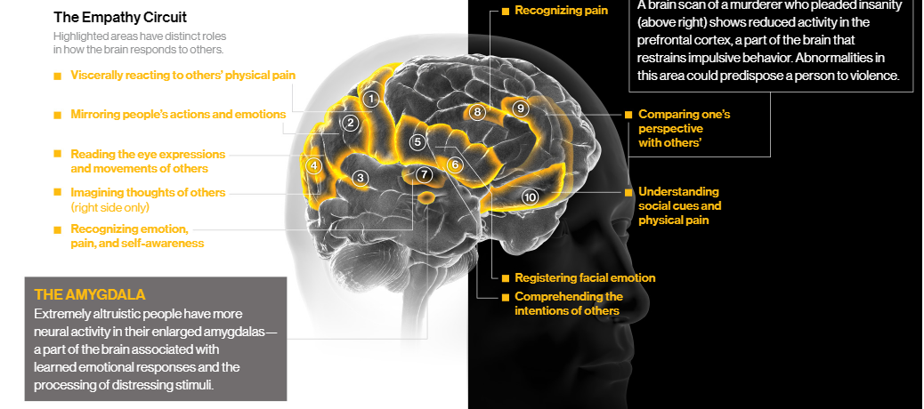

Slide 31
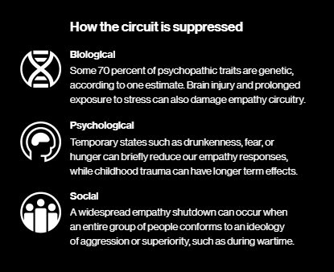
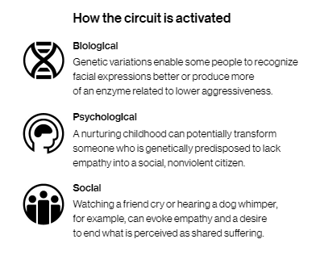

Slide 32
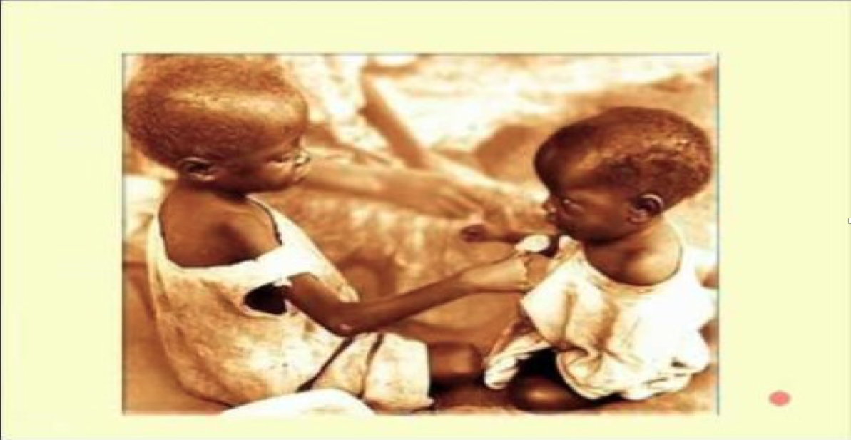

Slide 33


Slide 34



Compassion: Its Profound Impact on Health
It benefits the Receiver
It enhances the humanity of the Giver
It edifies the Observer
Nourishes the bond with receiver
Evokes gratitude
Encourages compassion towards others
Fires up brain areas that are activated by pleasure
Delivers a “helper’s high”
The Mother Theresa Effect (Harvard study)
Motivates and inspires you to be compassionate
All three parties feel morally uplifted, reap health benefits
Notes:
New trend in research

Slide 35
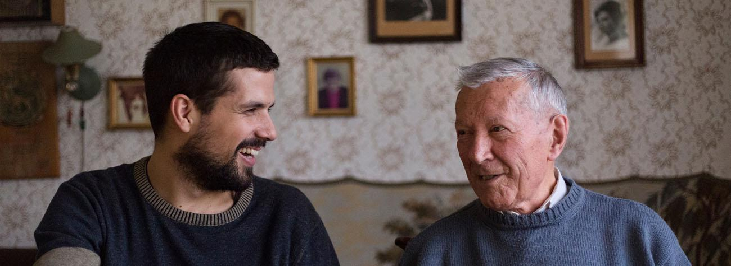
What Do Residents and Families Want in Eldercare?
Let’s Look at what Research has shown us.

Slide 36
An Important Discovery from Graduate School of Stanford Business Case M345
A study shows hospitals with the lowest employee satisfaction had the lowest patient satisfaction, and hospitals with the highest employee satisfaction had the highest patient satisfaction.
The Business Case for Happiness

Slide 37
Top Drivers for Recommendation to Others
Independent Living Resident |  | Assisted Living Resident
Home-Like Atmosphere | .61 | Responsiveness of Management | .61
Responsiveness of Management | .59 | Choices/Preferences | .60
Commitment to Independence | .58 | Comparison of Charges | .59
Care (Concern) of Staff | .57 | Competency of Staff | .59
Responsiveness of Staff | .56 | Care (Concern) of Staff | .58
Nursing Home Resident |  | Short Stay Residents
Care (concern) of Staff | .63 | Care (Concern) of Staff | .77
Competency of Staff | .63 | Competency of Staff | .77
Responsiveness of Management | .61 | Choices/Preferences | .74
Choices/Preferences | .59 | Responsiveness of Management | .72
RV/LVN/LPN Care | .58 | Quality of Medical Care | .72
*Each item is statistically correlated to the question “Would you recommend this community to others”

Slide 38
Top Drivers for Recommendation to Others
Assisted Living Family |  | Skilled Nursing Family
Competency of Staff | .72 | Care (Concern) of Staff | .76
Care (Concern) of Staff | .72 | Competency of Staff | .75
Responsiveness of Management | .70 | Choices/Preferences | .72
Choices/Preferences | .69 | Responsiveness of Management | .71
Responsiveness of Staff | .68 | RV/LVN/LPN Care | .71
*Each item is statistically correlated to the question “Would you recommend this community to others”

Slide 39
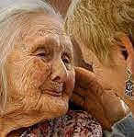
It’s all about compassion
But to whom?

Slide 40
Person-centered care
Our Professions Ultimate Goal

Slide 41





Who is that Person in Person-Centered Care?
Patient = a person suffering
Healer = one who makes the patient whole again
The elder is a patient Has a chronic condition
The family is a patient Needs emotional healing
The DON is a patient
Worried about staff for the next shift
The nurse is a patient She hears her sick baby crying for the mother
The CNA is a patient
Worrying she will bring COVID home or to her elders
The manager is a patient Worried about the shortfall in revenue

Slide 42




5 Primal Yearnings Define Us as Persons
To Be
To Become
To Belong
To Be Your Best
To Reach Beyond
To be alive, to be healthy to be safe, to have access to care, to die a dignified death
Life is precious given the odds of life
To be your own self, to be respected, to be free, to be in
control, to be fully informed and to have choices
To connect, to relate, to bond, to have family, to feel secure and be wanted, to love and be loved, to be with people, children, animals and nature
To self actualize, to be all you can be, to use your talent
To have a purpose in life, to find joy in good things and meaning in suffering
To rise above selfishness, to reach out and help others, to serve and to be compassionate
Notes:
Martyrs, solitary confinement, capital punishment

Slide 43
The art of compassionate management
It’s impact on the workplace

Slide 44
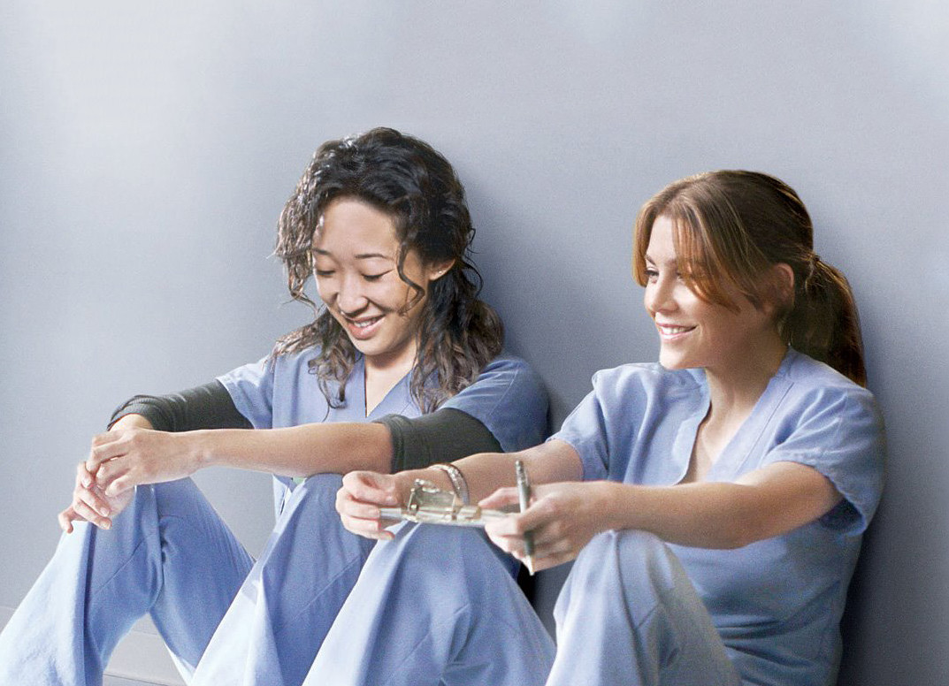
What do caregivers desire…..
Since they are the persons who provide most of the compassion (caring, comfort, kindness) which is so desired by our elders.

Slide 45
Top Drivers for Employees Recommendation to Others
Independent Living Employee |  | Assisted Living Employee
Care (Concern) of Management | .61 | Care (Concern) of Management | .69
Assistance with Job Stress | .59 | Assistance with Job Stress | .67
Attentiveness of Management | .58 | Attentiveness of Management | .66
Clear Expectations by Management | .57 | Clear Expectations by Management | .64
Support of Career | .56 | Fairness of Evaluations | .62
Skilled Nursing Employee
Care (Concern) of Management | .73
Attentiveness of Management | .71
Assistance with Job Stress | .69
Safety of Workplace | .63
Fairness of Evaluations | .61

Slide 46
Three Levels of Compassion
Compassion drives individuals to heroic deeds
Random acts of kindness
Compassion in Hitler’s prisoners in death camps
Evident in healthcare from CNAs to DONs
Compassion motivates a community to pitch in, in times of collective disasters
Floods, 9/11, Gander, Newfoundland
Disaster preparedness Has occurred in many Nursing Homes

Slide 47
Three Levels of Compassion
Compassion becomes an “Other”-Directed culture
All show respect, courtesy and trust
A sense of community prevails; each one to look out for the other
Mother Theresa established a community with a culture of compassion; religious groups has chalked up a distinguished history.
This is the ideal ELDERCARE we seek

Slide 48

Everyone is a Patient, Everyone is a Healer
Our private troubles follow us everywhere we go, even to work
They disturb our work, fellow workers and the care-recipients
A caring work setting, is a healing place--friends share each others’ burden and aches
A healing climate has a family feeling; docs, RNs, CNAs, residents, families know, care for and heal each other
We are all patients called to be healers

Slide 49
Awakening Compassion in our work lives
Notice
Interpret
Feel
Act

Slide 50
Noticing: The Portal to Awakening Compassion
Suffering that is never noticed will never be met with compassion.
Noticing suffering at work is picking up on cues
Not as engaged as usual
Unusual absences
Their bodies convey stress or tension
Their face displays sadness or anger
The meaning of suffering can differ across cultures and times of life
If we haven’t experienced a form of suffering it is sometimes hard to notice its subtle implications.
When suffering goes unnoticed in an organization, compassion fails.
A great leader is a “first-class” noticer!

Slide 51
Polling Question
I feel comfortable knowing about caregiver’s suffering and see this awareness as an important aspect of my work.
1) Never
2) Sometimes
3) Most of the time
4) Always

Slide 52
Polling Question
In the community where I work, I often have conversations in which I notice a caregiver’s suffering.
1) Never
2) Sometimes
3) Most of the time
4) Always

Slide 53
Interpreting: The Key to Responding with Compassion
You made this mess, now you suffer the consequences.
Considering someone as “blameworthy” shuts down compassion.
Suffering is often masked by errors or difficult work situations which trigger blame, not compassion.
Be curious about the causes of ambiguous or difficult work situations – cultivate more generous interpretations.
Default assumption: others are good and worthy of compassion
Don’t blame. Steer the conversation toward learning/coaching.
People who are different from us often seem undeserving of compassion in our eyes.
Remind yourself of others worthy of their humanity

Slide 54
Polling Question
In the community where I work, I tend to see caregivers who get behind or make mistakes in their work as in need of help and I approach them.
1) Never
2) Sometimes
3) Most of the time
4) Always

Slide 55
Polling Question
In the community where I work if I find out that a caregiver is having difficulty in his or her life, I tend to ask about it and focus on their well-being
1) Never
2) Sometimes
3) Most of the time
4) Always

Slide 56
Feeling: The Bridge to Compassionate Action
New studies show that we can pick up on suffering and respond with concern based on even the slightest facial expressions or voice cues.
Our work may put obstacles to responding to the above feeling.
We need to develop the skill to understand another’s perspective and determine what would be a helpful response
We need to develop empathic listening – tune into the feelings of concern as we hear another person’s perspectives and experiences-to be present to them
Identification with others at work is an important way that we can broaden our circle of concern and awaken compassion.

Slide 57
Polling Question
I often feel concern for the caregivers in my community
1) Never
2) Sometimes
3) Most of the time
4) Always

Slide 58
Polling Question
I find it easy to take the perspective of others in our community.
1) Never
2) Sometimes
3) Most of the time
4) Always

Slide 59
Acting: The moves that alleviate suffering at work
At work, compassion is expressed in action
and is often improvisational.
Managing with compassion is learned and developed through practice.
Examples of compassionate actions are:
Flexible time/work schedule to cope with suffering
Buffering someone suffering from task and information overload
Monitoring and checking in with the suffering person
Generating resources that will alleviate suffering
Designing rituals that convey the support of the community

Slide 60
Polling Question
I often find myself taking action to help others in in our community
1) Never
2) Sometimes
3) Most of the time
4) Always

Slide 61
Polling Question
If I found out that caregiver’s in our community were suffering, I would very likely know what to do to comfort them.
1) Never
2) Sometimes
3) Most of the time
4) Always

Slide 62
“You need to know and really, really, understand that your nurses and aides wield the power to make or break your business.”
Judah Gutwein, LNHA,
CEO of Sky Care Media LLC
Notes:
However, the bottom line is, your CNAs and nurses will be the ones providing the care. If they just "don't get it," you could have the very best, most dedicated and compassionate department heads in the industry and you will still be deserving of your low ratings and shameful consumer feedback

Slide 63
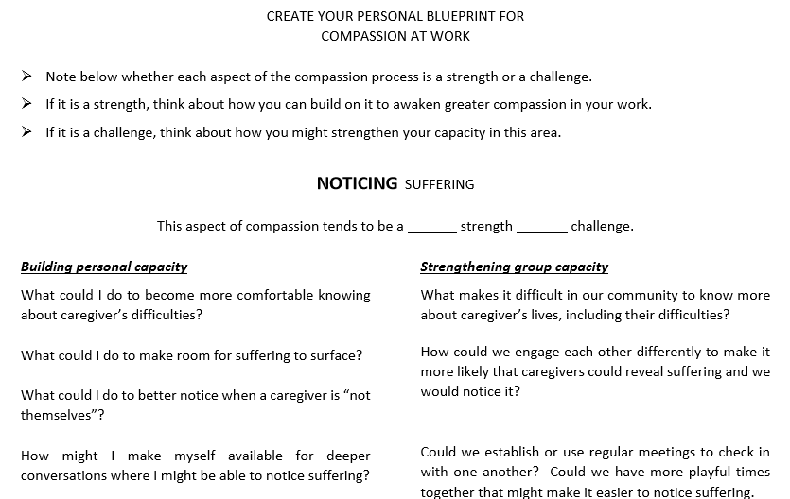

Slide 64

Make Decisions with Your Head but Implement Them with Your Heart

Slide 65
Training in Compassion
A new study, just published online by Psychological Science, shows that training adults in a loving-kindness-style “compassion meditation” actually makes them significantly more altruistic toward others
Meditation gives people a heightened awareness of their surroundings and enhances our ability to take the perspective of other people

Slide 66
How Meditation Works
The compassion meditation gently instructed the participants to extend feelings of compassion toward different people, including themselves, a loved one, a casual acquaintance, and someone with whom they’d had difficulty
https://ggia.berkeley.edu/practice/loving_kindness_meditation

Slide 67

https://self-compassion.org/wp-content/uploads/2015/12/self-compassion.break_.mp3

Slide 68
In Conclusion
Here is the link to the meditation helping you to be compassionate with yourself:
https://self-compassion.org/wp-content/uploads/2015/12/self-compassion.break_.mp3
The residents in your communities and their families, more than anything, want compassionate caregivers.
Your caregivers, more than anything (pay, benefits etc), want management to show they care for the caregivers.
Creating a culture of compassion in your community is the greatest thing you can do to decrease turnover, increase employee and satisfaction, and improve quality within your community.
As nurse leaders, be committed to The Art of Compassionate Management.

