Slide 1




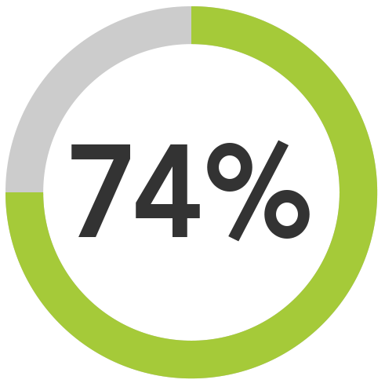


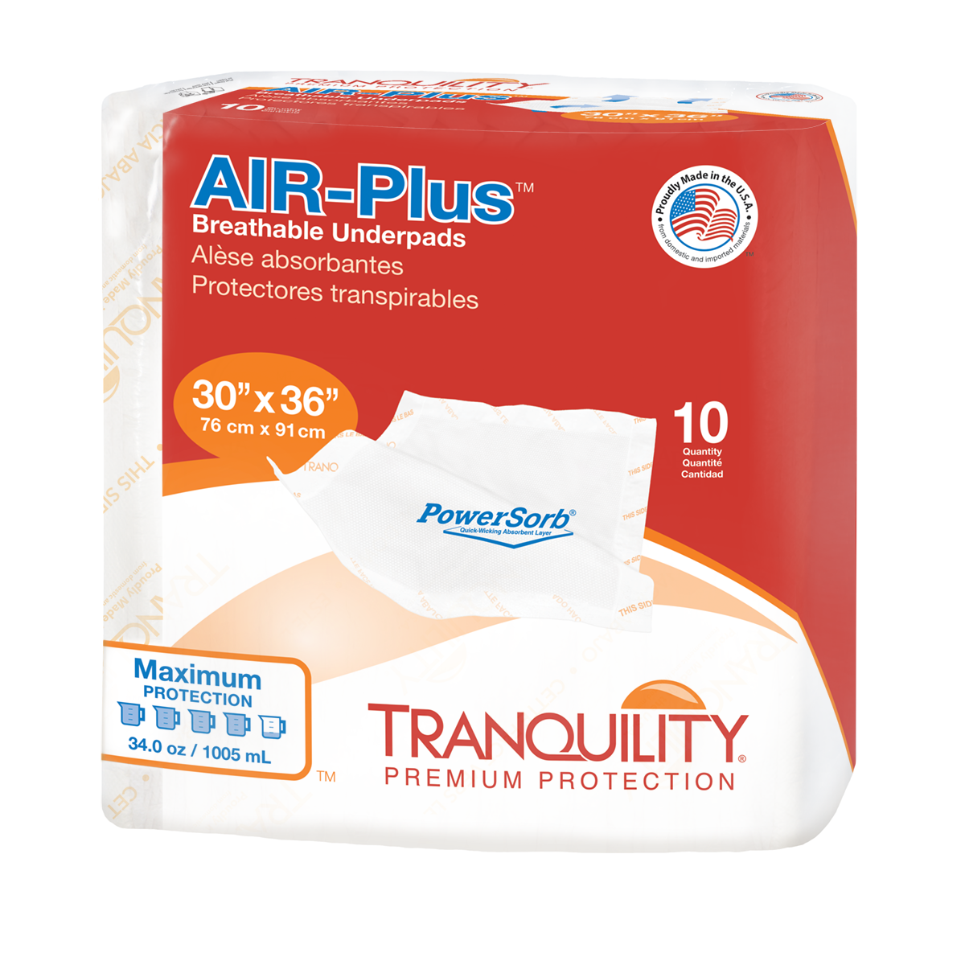
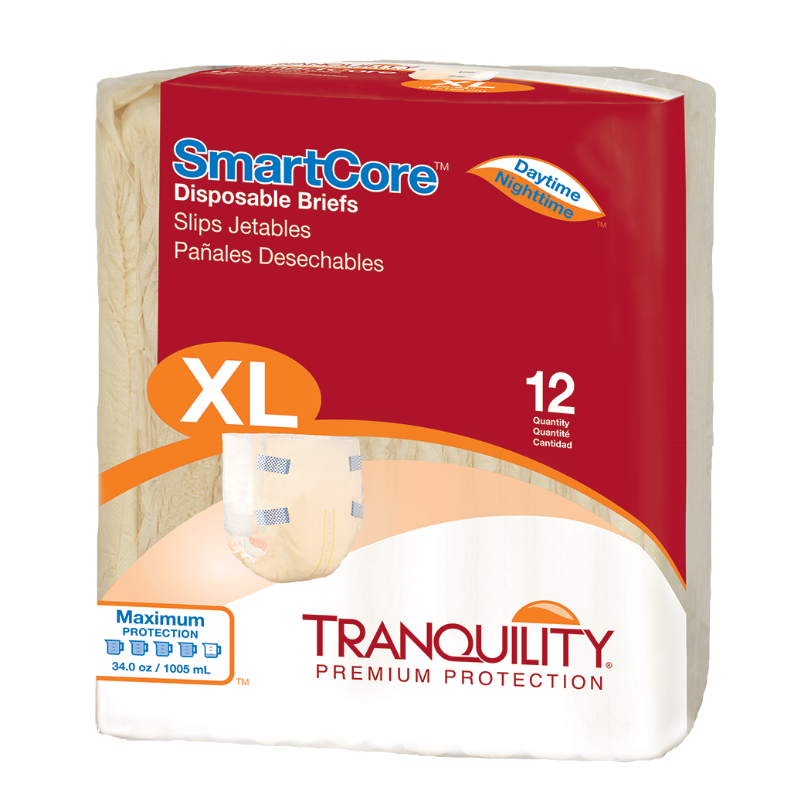
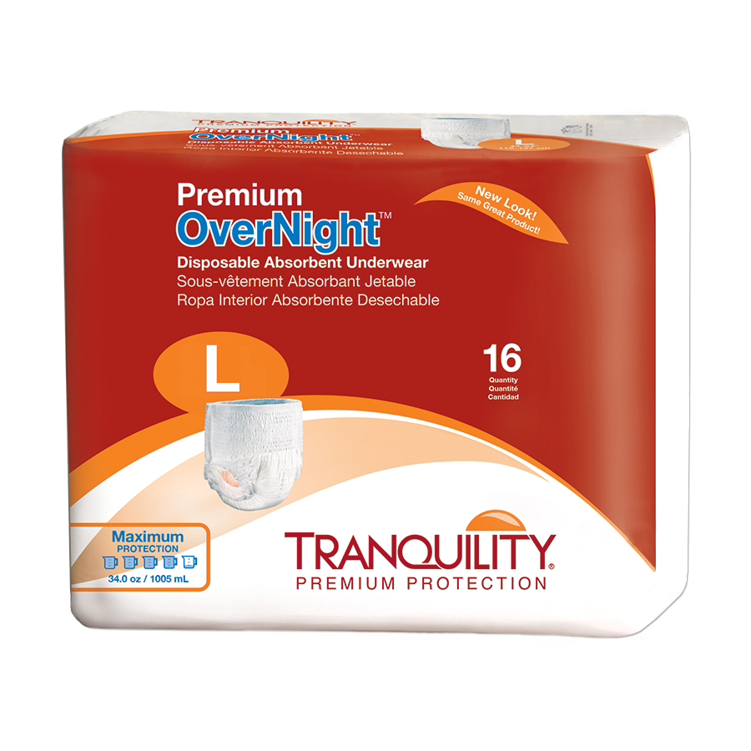
FSS Contract #:
V797D-50560
(03/01/2016 – 02/28/2021)
DAPA Contract #:
VA119-18-PA-0110
DUNS: 00-503-8856
Cage Code: 52044
Primary NAICS: 322291
NAICS: 315110, 316210, 322220, 322299, 325412,
326199
Status: Small Business
ABOUT US
A family-owned business proudly producing innovative, high-performance niche absorbent products for 60 years.
Contact me for a no-cost trial!
of VAMCs are using Tranquility Premium Incontinence Products
Steve Sczesny
Senior National Account Executive
1-800-467-3224 ext. 313 • sez@pbenet.com
Visit our resource center for Managing Incontinence During COVID-19
Click to hear what this VA has to say!
Tranquility is the fastest growing incontinence brand
in outpatient pharmacy, ¹ improving quality of life
for Veterans and Caregivers.
1 CMOP Rx Data 2019

Slide 2
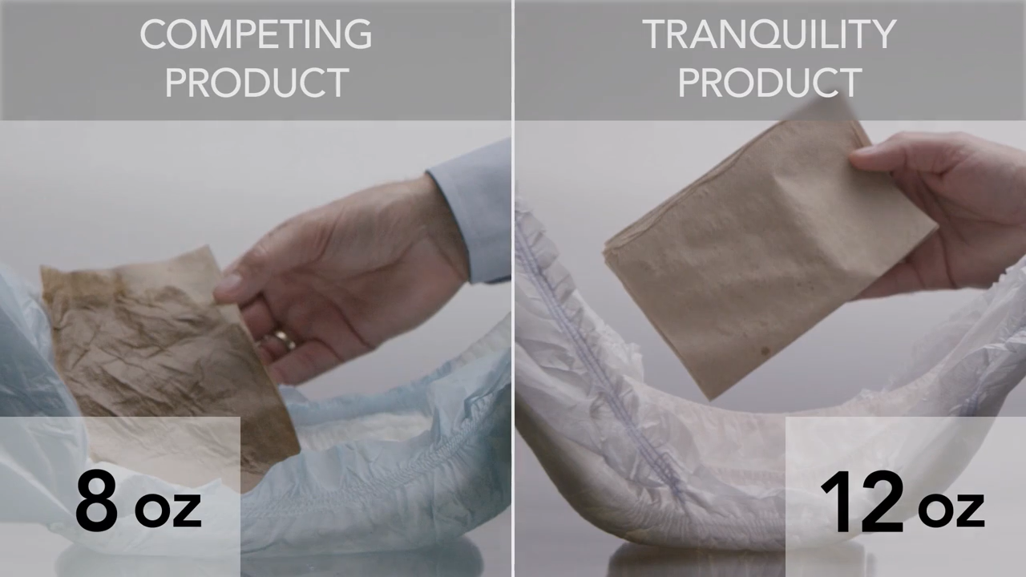

See the Tranquility difference for yourself:
VA clinical trials prove patients, staff, and facilities benefit with Tranquility products!
Improved sleep, overall skin health, and quality of life for patients.
Less product, clothing, and linen changes reduce risk of injury and increase staff satisfaction.
Reduction in overall spend on incontinence products, ancillary items, and labor.
Don’t just take our word for it!
to see outcomes from other facilities like yours!
VIDEO DURATION: 2 MIN
Principle Business Enterprises, Inc. | For a no-cost trial, contact: Steve Sczesny • 1-800-467-3224 ext. 313 • sez@pbenet.com • TranquilityProducts.com

